Slide 1
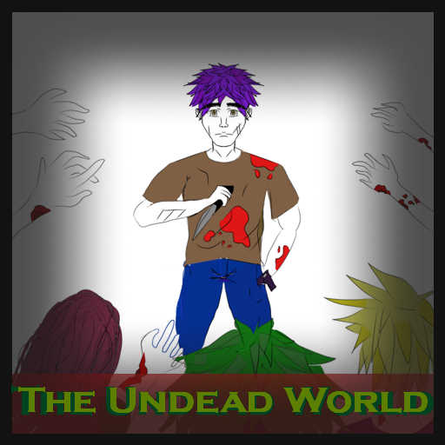
Game Prog. Project
Denmar Ermitano Valentin Georgiev Tracey Vergara December 10 2020

Slide 2
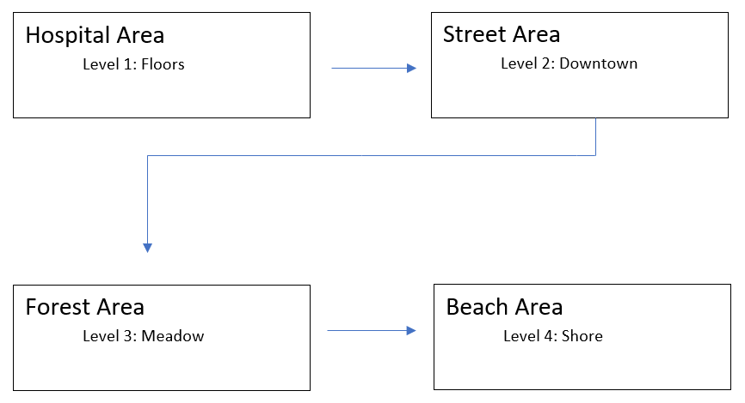
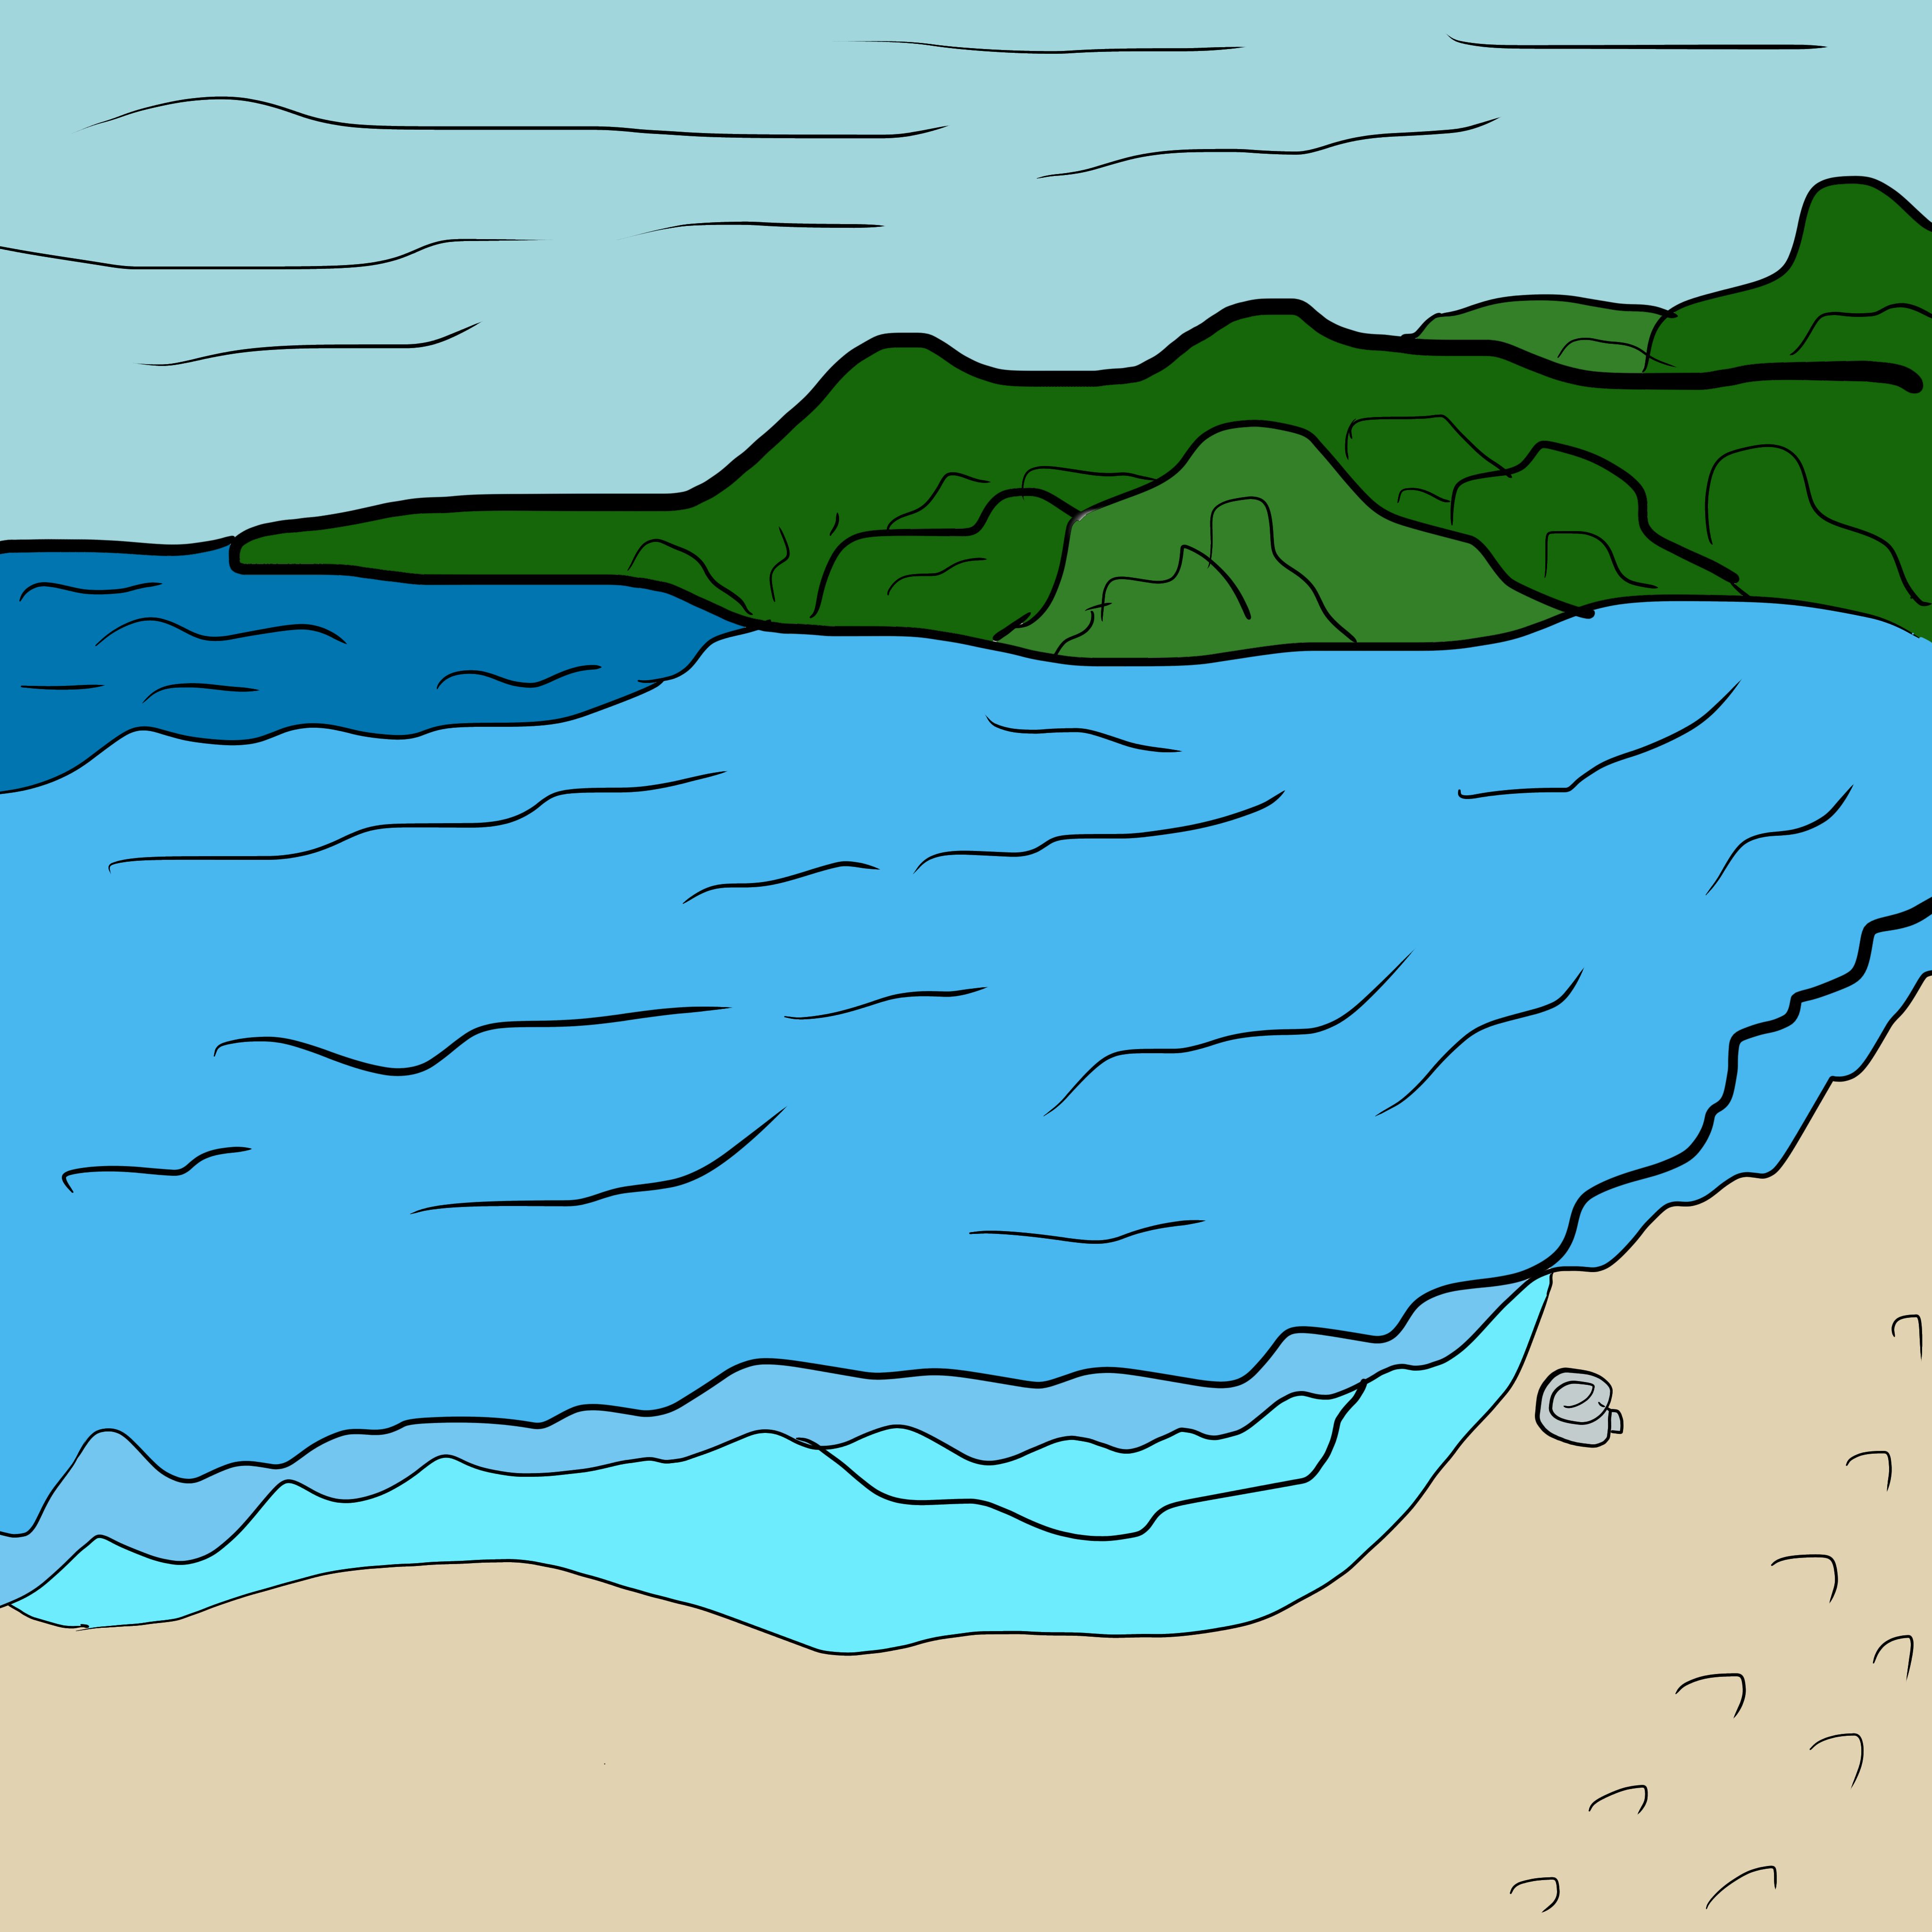
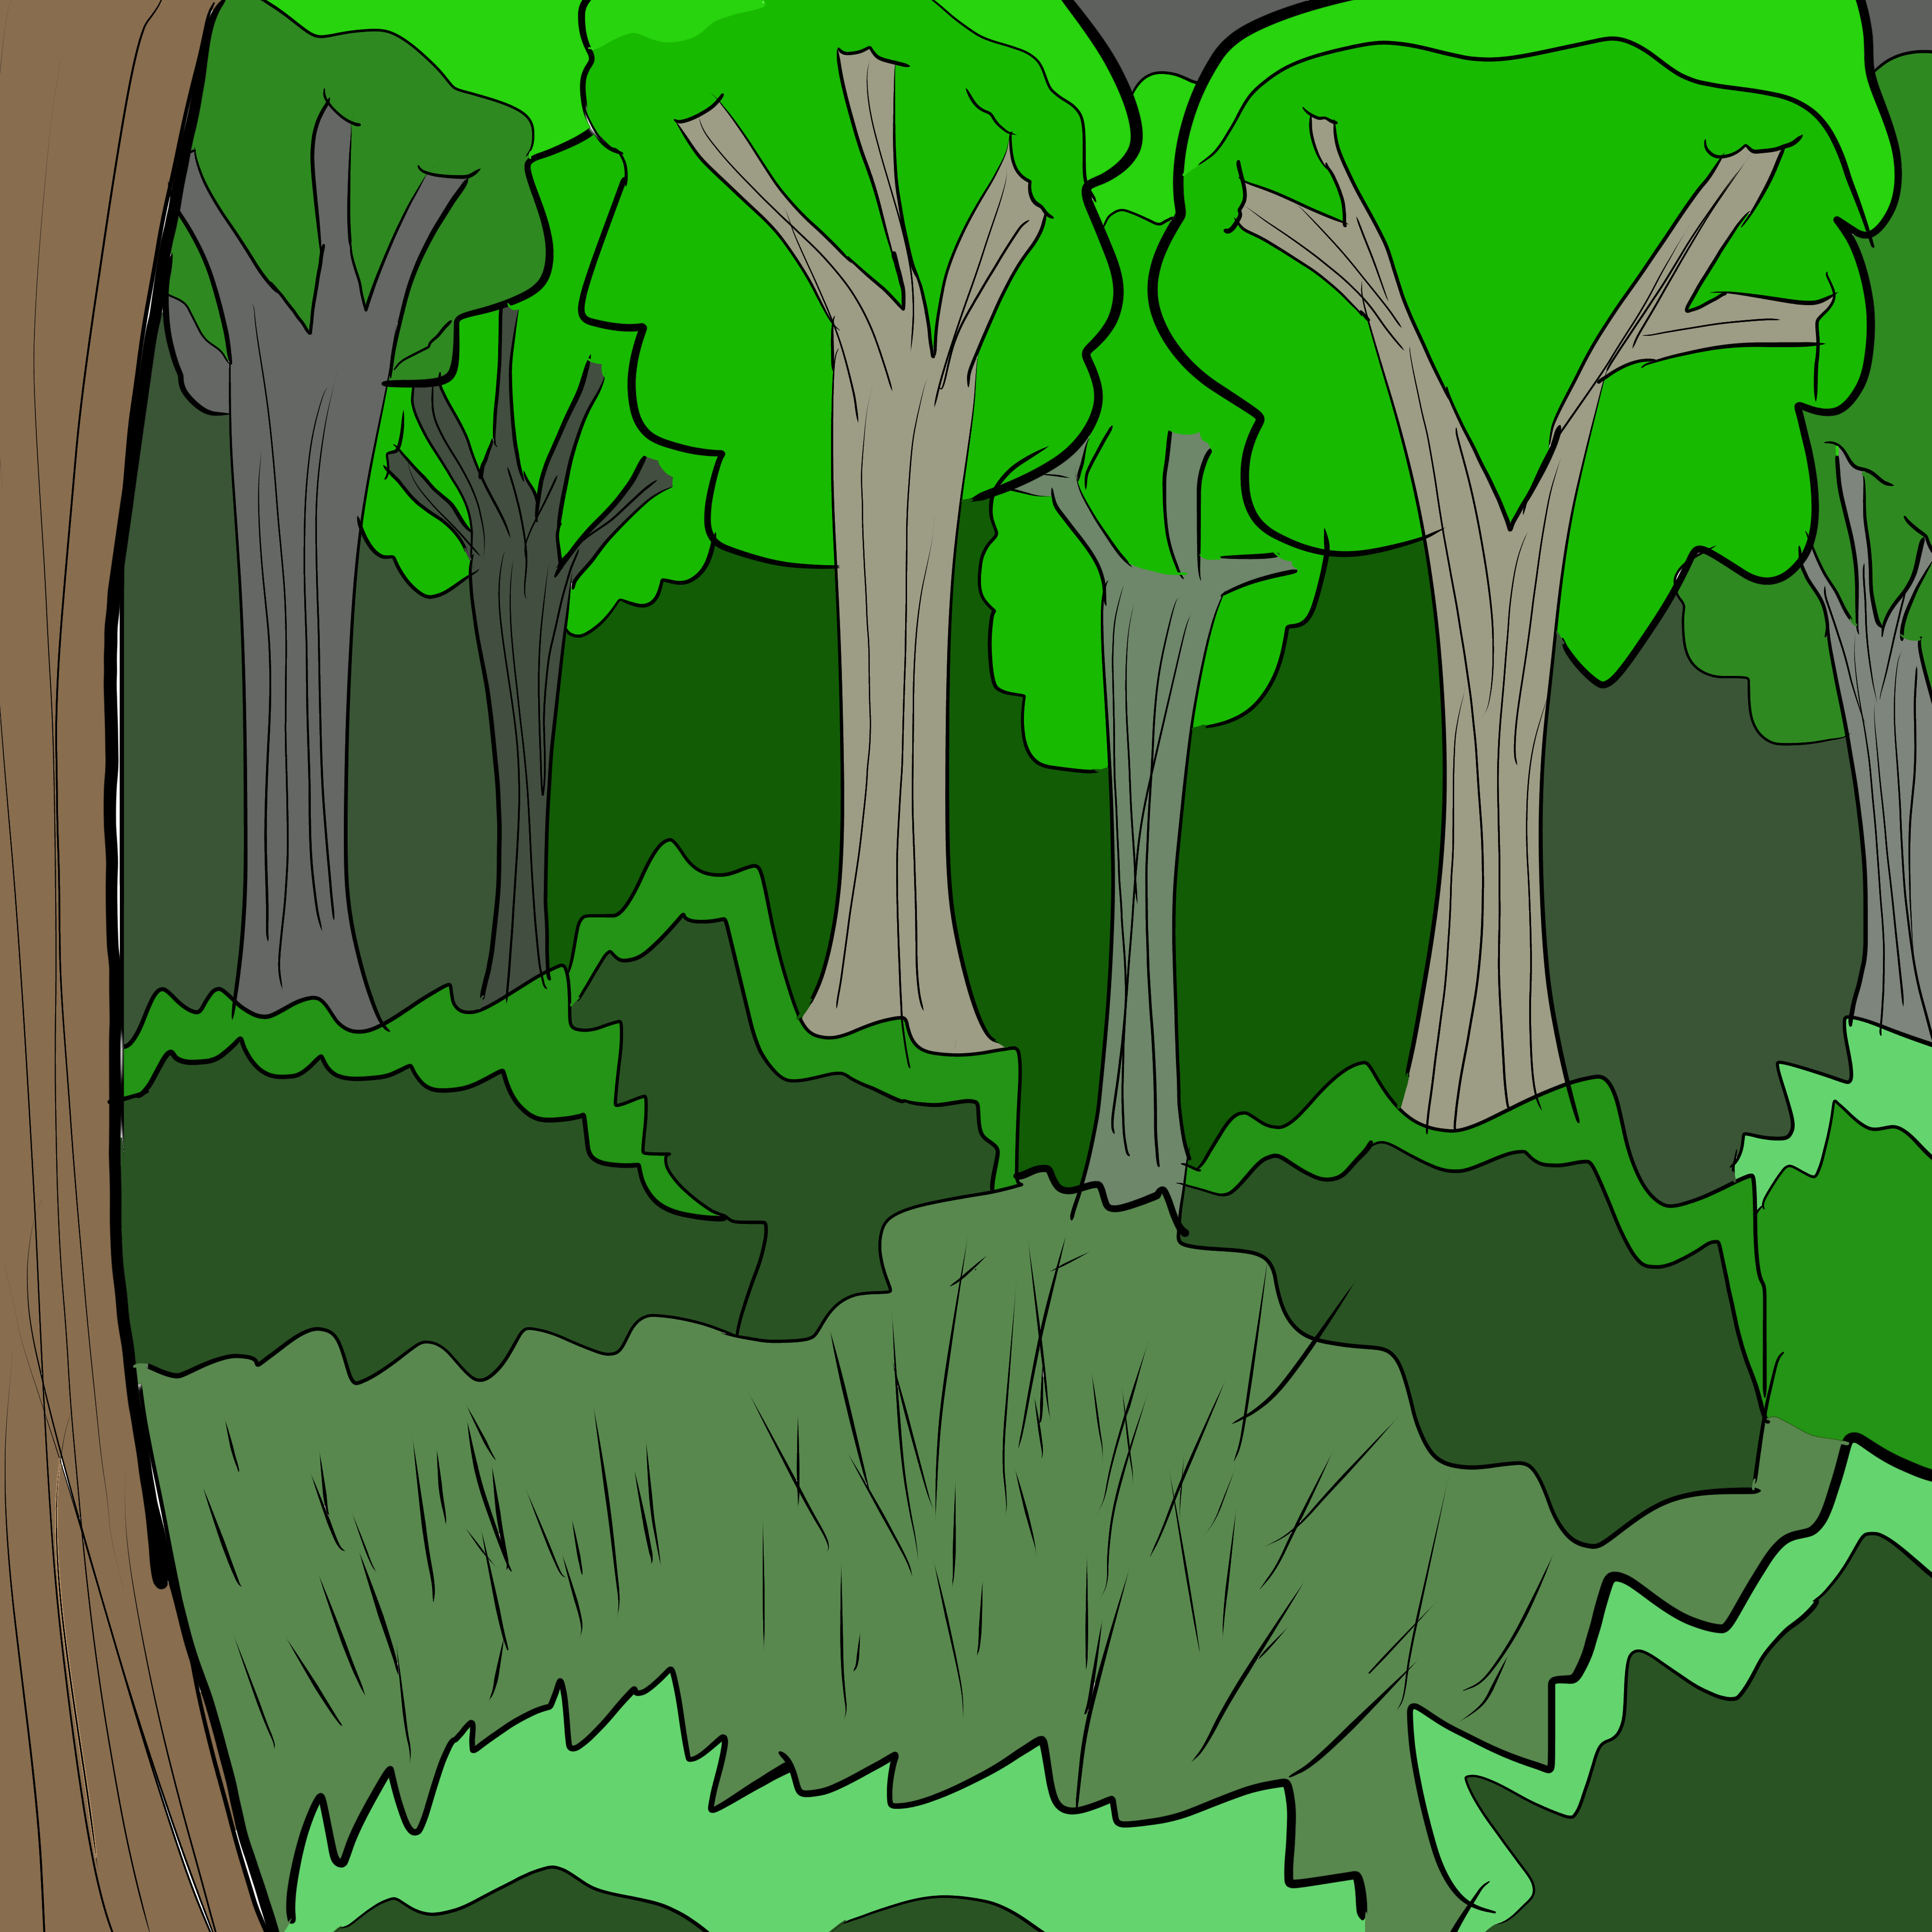
GDD:
UI MOCKUP: LEVEL DESIGN
TRANSITION WORLDS
BEACH
&
FOREST

Slide 3
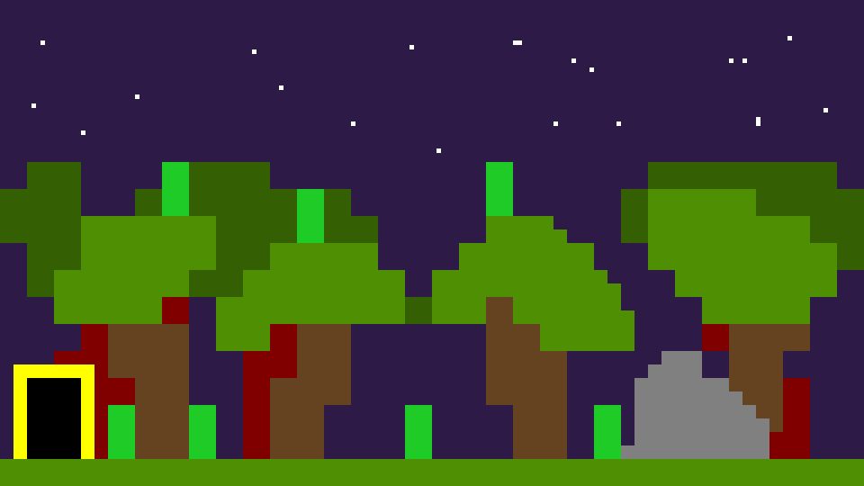
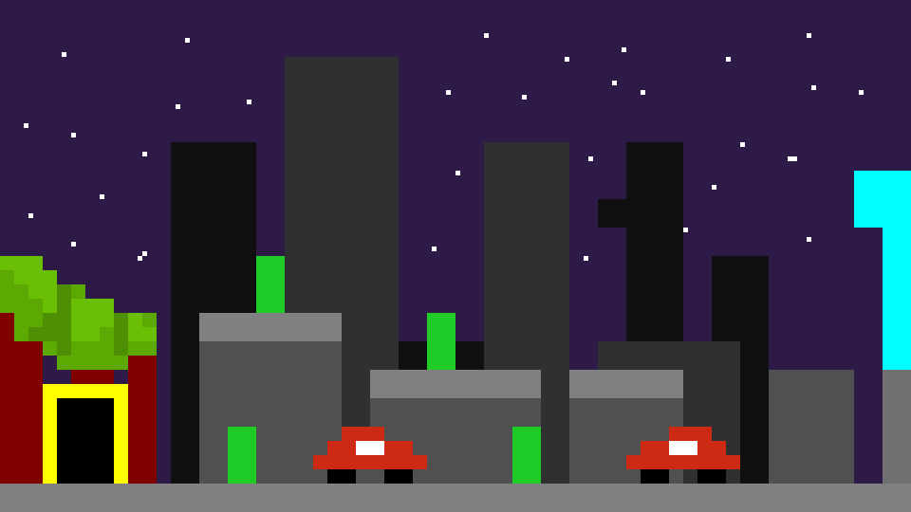
GDD:
LEVEL DESIGN DRAWINGS
FOREST & CITY -Position objects in the world
-Control difficulty

Slide 4
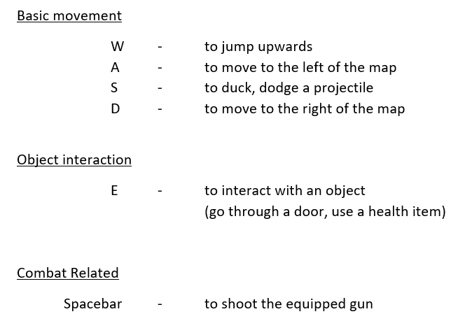
How do I play?
CONTROLS
The ones you all love WASD + E + SPACE
Kill the zombies Find the exit (Yellow doors) Don’t die…

Slide 5
Contributions
Implementing the different worlds, the map Members: Tracey, Denmar Inputting the objects and the player model with movement Members: Denmar, Valentin Implementing the different weapons and items Members: Valentin, Tracey Inputting the enemies and their movement Members: Valentin, Denmar Write the text to guide the player Members: Tracey, Valentin Adding soundtrack Members: Valentin, Tracey, Denmar Adding sound effects and feedback sounds Members: Tracey, Denmar Finishing touches Members: Denmar, Valentin, Tracey

Slide 6
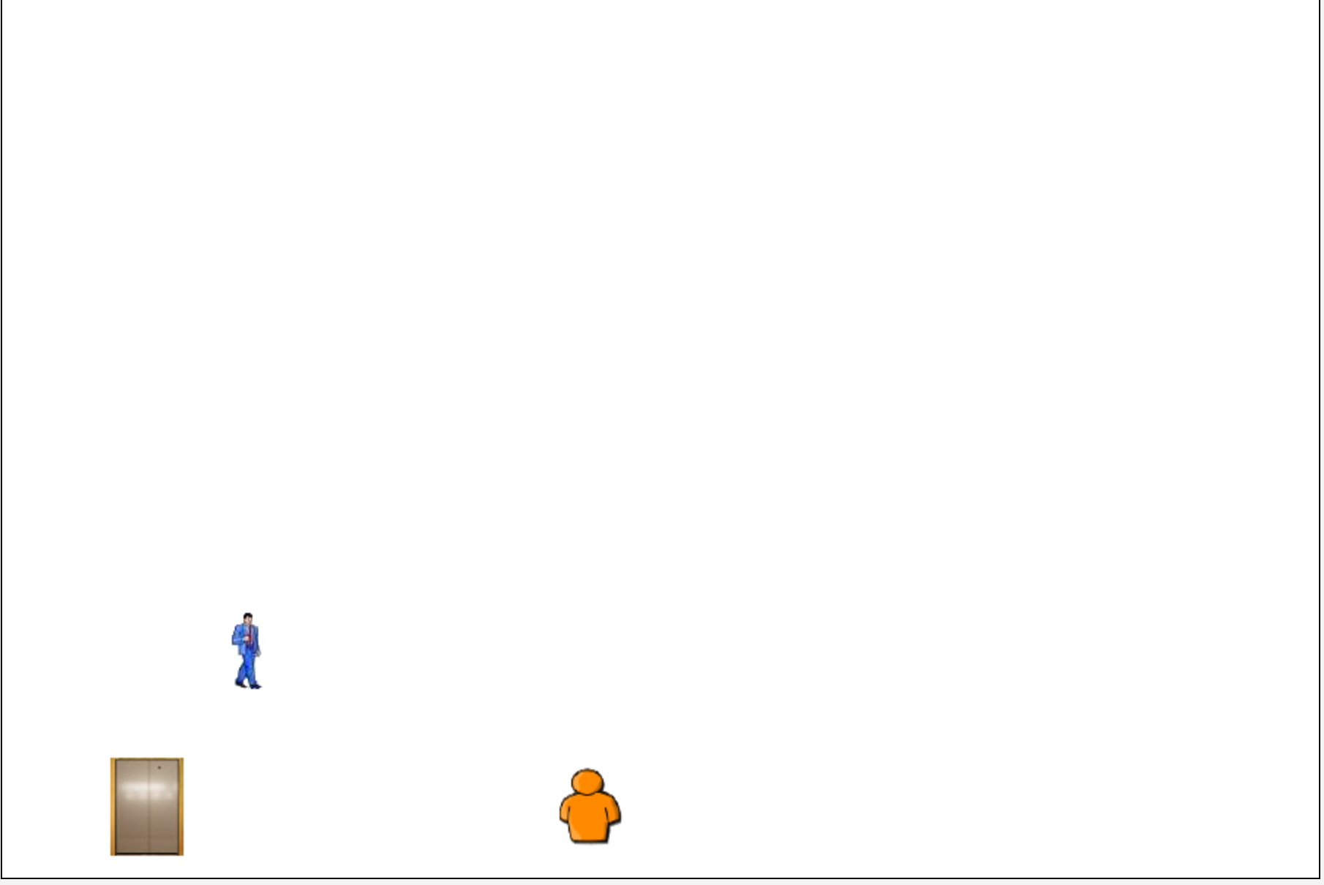
Challenges: Jumping & Gravity
mrrrr
Jumping = Floating no point to the game

Slide 7
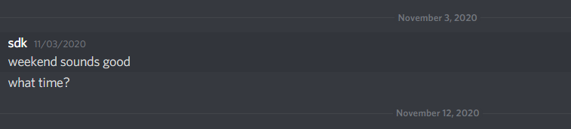
Challenges: Schedules
Differing schedules
Communication
Time management

Slide 8

Challenges: Github
commit
commit
commit
push
pull
push
pull
commit
push

Slide 9
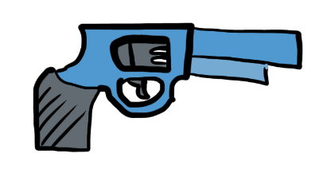
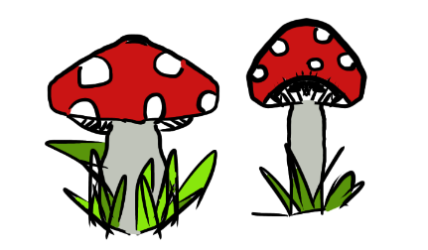

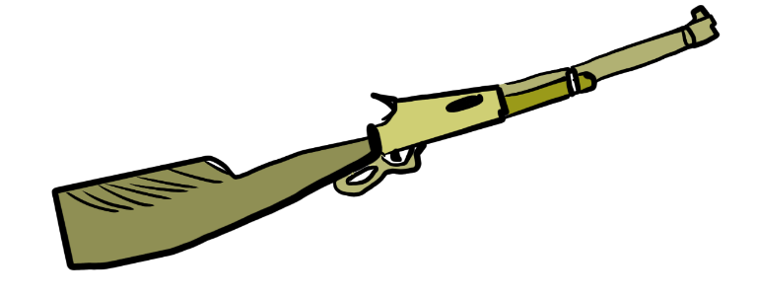
Possible Enhancements
Better backgrounds
+ controls
+ levels
+ characters
+ world interaction

Slide 10
Questions?
?
?

